Slide 1
A New Approach to Assessing
Esophageal Mucosal Integrity
Instantly detect GERD, EoE, and Non-GERD
and monitor treatment response in GERD
and EoE with MiVu™

Slide 2
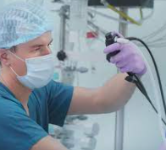
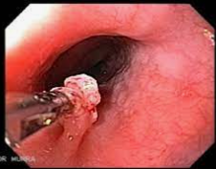
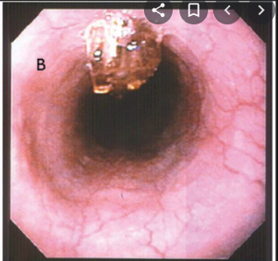
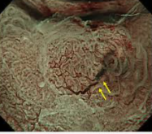
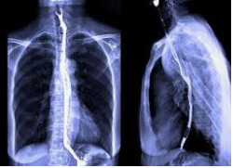
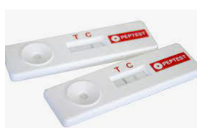

Slide 3
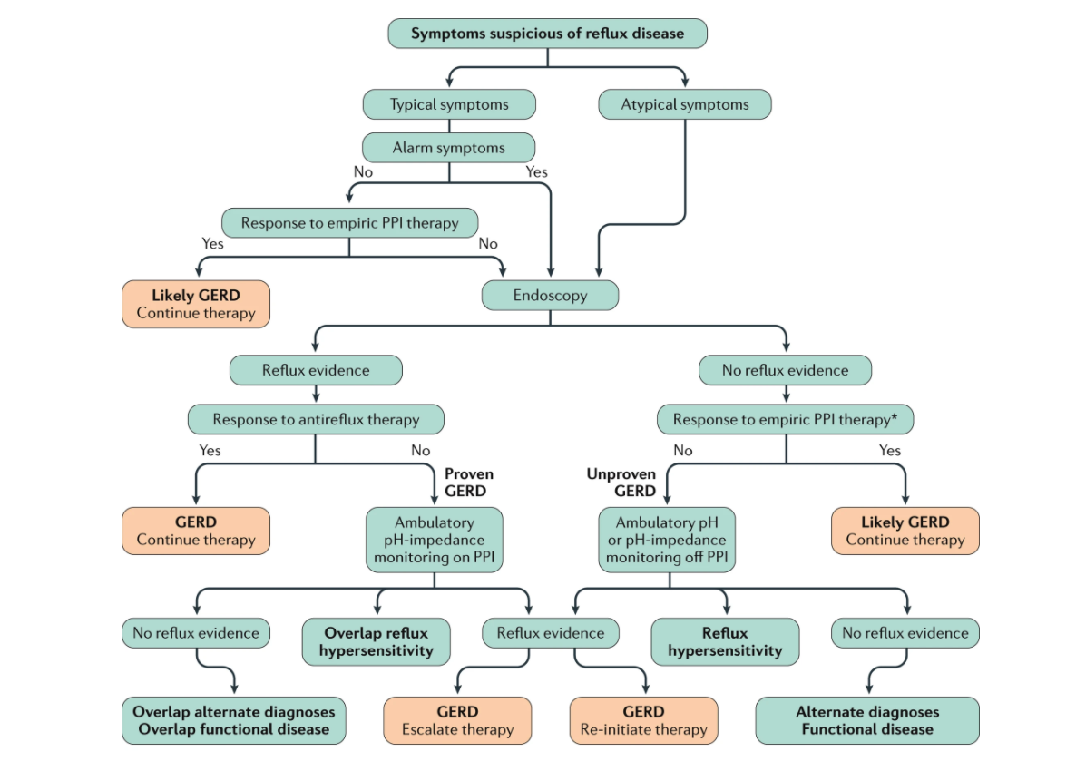
CURRENT ALGORITHM

Slide 4
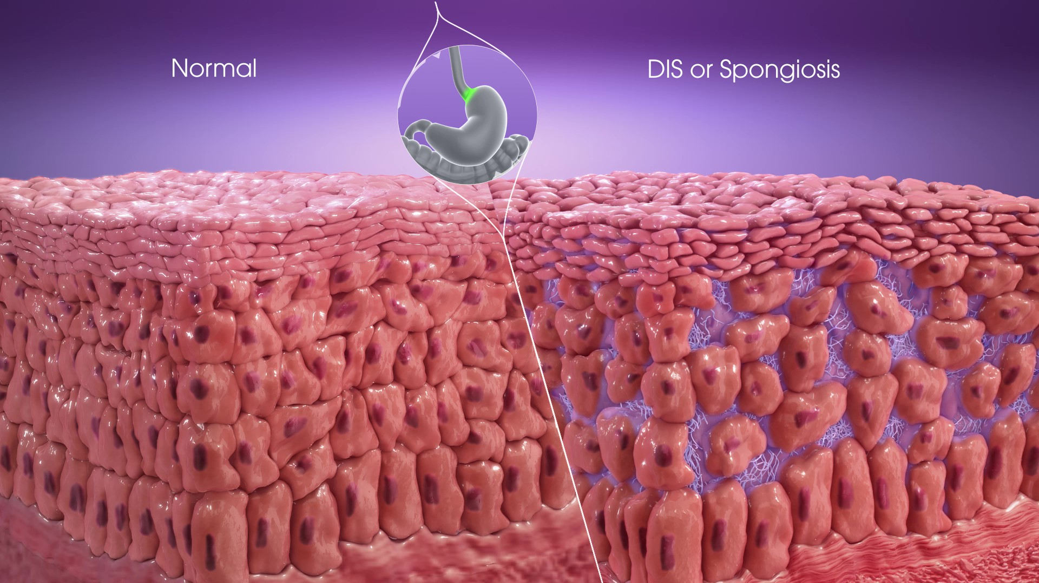
Notes:
This pic is an example of the two types of mucosal lining-Healthy Tissue on the LT. DIS/Spongiosis on the RT
If you have Edema- you have fluid—Spongiosis /DIS= your Mucosal Integrity is Poor= lower Imped –
LT – If you have tight spacing throughout the cells; No Fluid = High MI High Imped
We know from Histology GERD has Edema & Fluid in the cells
If we run current through the Esophageal Lumen- It conducts -Fluid conducts electricity = Low Imped
IF you have low current through the tissue= healthy tissue- no edema, fluid =High Imped= MI
The studies show that MiVu instantly detects changes in Esoph Mucosal integrity during endoscopy and identifies patients with GERD or EOE or Non GERD

Slide 5
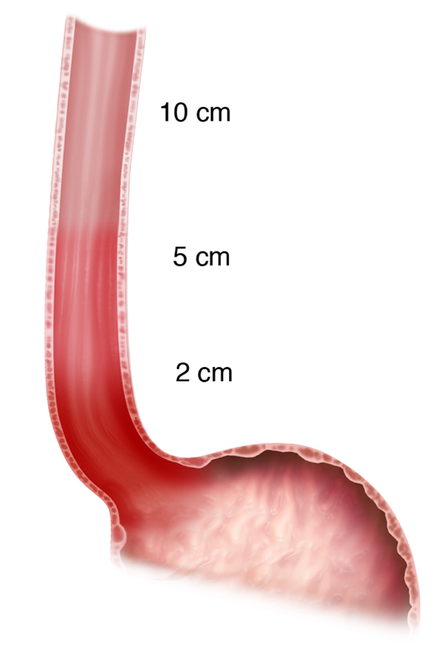
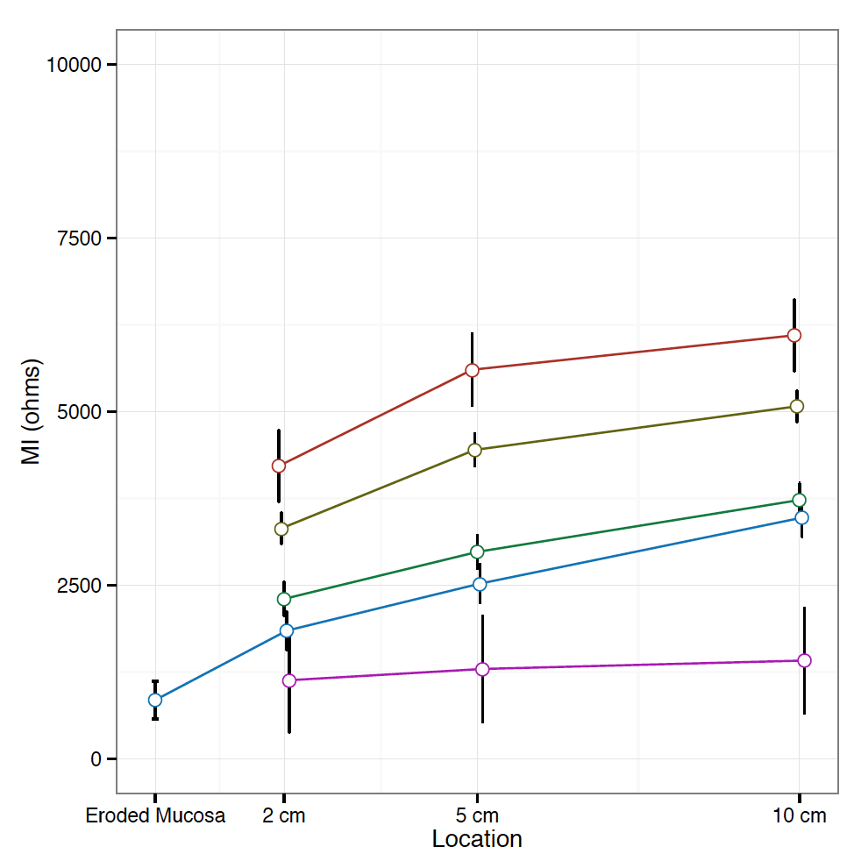
Non-GERD
Achalasia
E-/pH-
E-/pH+
E+
GERD
EoE

Slide 6
Non-GERD
GERD
EoE
Notes:
Here is a view of the Software
Blue \/Yellow nice soft calming colors Higher OHMS
GERD more red lower OHMS
EOE Red all up and down the esophagus. High OHMS

Slide 7
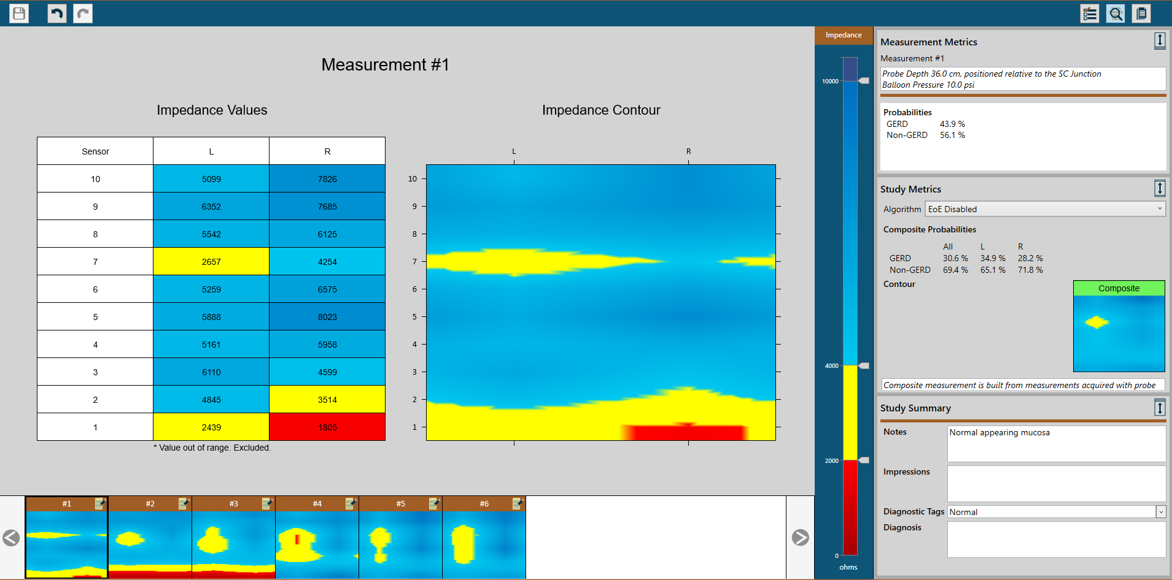
Notes:
Another view of the software
On left you have sensors 1-10 1 correlating with the stomach and 10 to the head
EACH sensor takes 10 readings- Those readings are averaged per each sensor.
Looks at OHMS readings 0-10000 vers slope which is the length of the esoph
It then provides a post test Probability – IN this test you have higher OHMS reading (blue/yellow)
Red would be lower 0-2500
In the upper right hand corner shows 33% GERD 67% NoN- Picks the 2 best correlated captures (6)- most similar-reproducible provides Doc with Prob metrics

Slide 8
CLINICAL
Gastroenterology 2015;148:334-343 - Proof of concept study
The MI pattern along the esophageal axis is signiﬁcantly different in patients with GERD (erosive or non-erosive reﬂux disease) or EoE compared to patients without GERD or patients with achalasia
The MI pattern also had higher speciﬁcity (95%) and positive predictive values (96%) compared to wireless pH monitoring (64% and 40%, respectively) for identifying patients with esophagitis
Gastroenterology 2019; 156:1617-1626 – Prospective, double-blinded study
Using MI pattern along the esophageal axis, MI accurately predicted EoE during endoscopy with a sensitivity of 100% and specificity of 96% without the need for histology
using MI pattern along the esophageal axis, MI accurately predicted EoE during endoscopy with a sensitivity of 100% and specificity of 96% without the need for histology
Notes:
2 Studies published in the Premier GI Journal Gastroenterology N296
& the study compared MI vs gold standard Bravo- showed higher specificity 95% compared to 64% for Bravo & 96% PPV vers 40% Bravo
REPEAT: 95% Spec vs 64% Bravo
96% PPV vs 40%
95-96% are incredible high values
Also showed that MI can differentiate between GERD –NON GERD- & EOE; It detects GERD even if you cant see it
It has a different pattern form GERD & EOE and can delineate the two.

Slide 9
Mucosal Impedance Discriminates GERD From Non-GERD Conditions - Gastroenterology 2015;148:334-343
Primary Endpoint: Is Mucosal Integrity testing a valid substitution for PH Testing (proof of concept)
Type of study: Prospective longitudinal
Total Patients: 268 (GERD, Non-GERD, EoE, and achalasia)
All patients had EGD, 48-hour wireless pH test and MiVu (2,5, and 10 cm)
MI versus Wireless pH Specificity : 95% Versus 64%
MI versus Wireless pH Positivity: 96% Versus 40%
First Generation Prototype balloon
Notes:
2 Studies published in the Premier GI Journal Gastroenterology N296
& the study compared MI vs gold standard Bravo- showed higher specificity 95% compared to 64% for Bravo & 96% PPV vers 40% Bravo
REPEAT: 95% Spec vs 64% Bravo
96% PPV vs 40%
95-96% are incredible high values
Also showed that MI can differentiate between GERD –NON GERD- & EOE; It detects GERD even if you cant see it
It has a different pattern form GERD & EOE and can delineate the two.

Slide 10
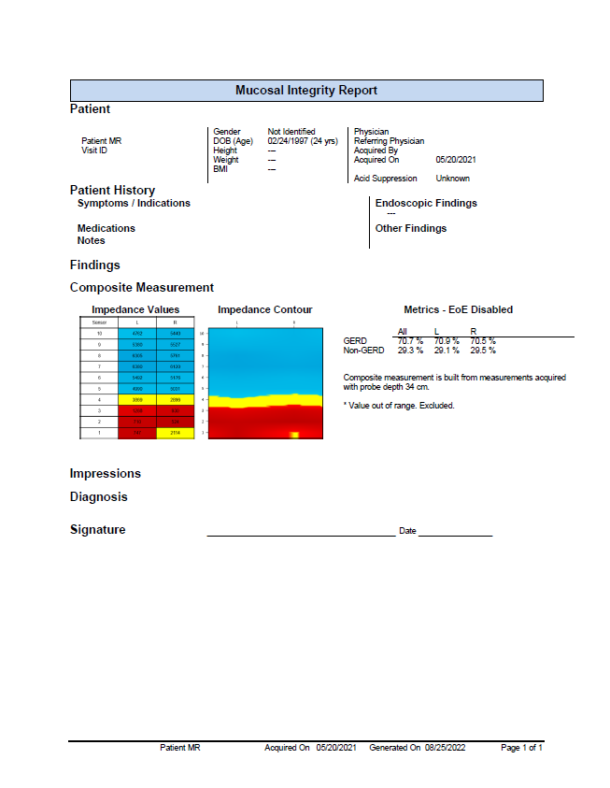
GERD Summary Report

Slide 11
A New Approach to Assessing Esophageal Mucosal Integrity
Instantly detect GERD, EoE, and Non-GERD and monitor treatment response in GERD and EoE with MiVu.™
Objective evidence
Real Time Data
Quick and Efficient
Single Point of Care
Convenient and Comfortable for Patient
Immediately Direct Patient Care
Easy to Implement in Hospital or ASC
Streamline ARS/TIF/LINX workup
CPT Code C9777
Notes:
2 Studies published in the Premier GI Journal Gastroenterology N296
& the study compared MI vs gold standard Bravo- showed higher specificity 95% compared to 64% for Bravo & 96% PPV vers 40% Bravo
REPEAT: 95% Spec vs 64% Bravo
96% PPV vs 40%
95-96% are incredible high values
Also showed that MI can differentiate between GERD –NON GERD- & EOE; It detects GERD even if you cant see it
It has a different pattern form GERD & EOE and can delineate the two.

